Slide 1
Introduction to LaTex
SE PROJ

Slide 2
What is LaTex
LaTeX (pronounced lahtekh or laytekh) is a typesetting program, not a word processor.
It is written on an ordinary text editor and translated by means of a program into a finalized version, usually in pdf format.
Formatting codes are embedded in the text.
Equations, symbols, tables, etc. are created by means of formatting codes.

Slide 3
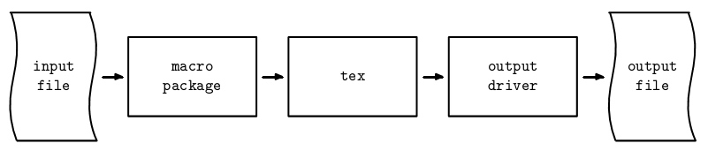
Using LaTex
TeX
LaTeX

Slide 4
Editors
TeXnicCenter (Windows only)
Texstudio
Eclipse
Led
WinEdit (commercial)

Slide 5
Advantages?
Professional typesetting
Best output
It is the standard for scientific documents
Processing Mathematical (& other) symbols
Meaning based structuring (rather than appearance)
Knowledgeable and helpful user group
Its FREE!
Platform independent

Slide 6
Basic Document Structure
{article}
{report}
{book}
{letter}
Basic Classes
\documentclass{article}
\begin{document}
This is some sample text.
\end{document}
Notes:
Simple text file. You can use your fav text editor to write it. Like notepad, vi, emacs.
Commands start with backslash “\”
Arguments for the commands are placed inside curly braces “{ }”
Optional arguments are placed inside square brackets “[ ]”

Slide 7
Explanation
Every LaTeX file begins with \documentclass{...}
This begins a section called the “preamble”, which contains global instructions for the file. \usepackage{...} commands and others are placed here.
After the preamble, the body of the text begins with \begin{document}.
At the end of the file is \end{document}.

Slide 8
Caution
LaTeX is very unforgiving of errors. Everything must be exactly right in order for it to work.
If you type ( instead of {, or if you use a reserved character such as _, it will crash or do something unintended.
This is one reason why a well tested template is very helpful.

Slide 9
Preamble
After %, LaTeX ignores the rest of the line.
\documentclass{article} causes LaTeX to format the text as an article with set formatting rules.
\usepackage{...} specifies an exception or addition to the set formatting rules. Multiple packages can be used.

Slide 10
Making Cover page
\begin{document}
\title{...}
\author{...}
\date{...} (Put % in front of it to suppress.)
\maketitle (Title and name appear here.)
\end{document]

Slide 11
Report Sections
\chapter{…}
\section{...}
\subsection{...}
\subsubsection{...}
(These will be numbered: 1., 1.1., 1.1.1.)

Slide 12
Figures & Tables
Figures & Tables cannot be broken between pages
They are “floated”
\begin{figure}
\includegraphics{sample}
\caption{A sample figure.}
\end{figure}

Slide 13
Cross-referencing
\label{marker} \ref{marker} \pageref{marker}
\section{Introduction}
\label{intro}
…
As mentioned in section \ref{intro} in page \pageref{intro}

Slide 14
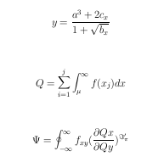
Some Math
\begin{center}
{\large
$$ y=\frac{a^3+2c_{x}}{1+\sqrt{b_{x}}} $$ \\
\vspace{0.2in}
$$ Q=\sum_{i=1}^{j}\int_{\mu}^{\infty}f(x_{j})dx $$ \\
\vspace{0.2in}
$$ \Psi = \oint_{- \infty}^{\infty}f_{xy}({\frac{\partial
Qx}{\partial Qy}})^{\Im_{\pi}^ \prime} $$ \\ }

Slide 15
Questions?

